Slide 1
Modelling Exercise
Brian Foo

Slide 2
Overview of modelling process
P07 and P08 were modelled separately from the ‘main’ group due to large missing gaps
Gradient boosting regressor models were used to for both the P07_P08 and ‘main’ cases. In each case, models for low, medium, and high quantiles were trained to give an operating range for the plant dosing
The models scored well ( >0.9) in terms of R²

Slide 3
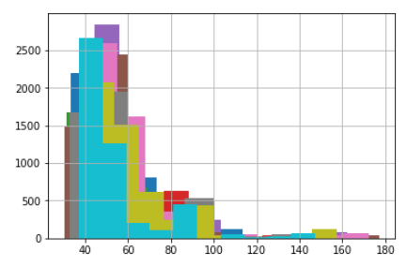
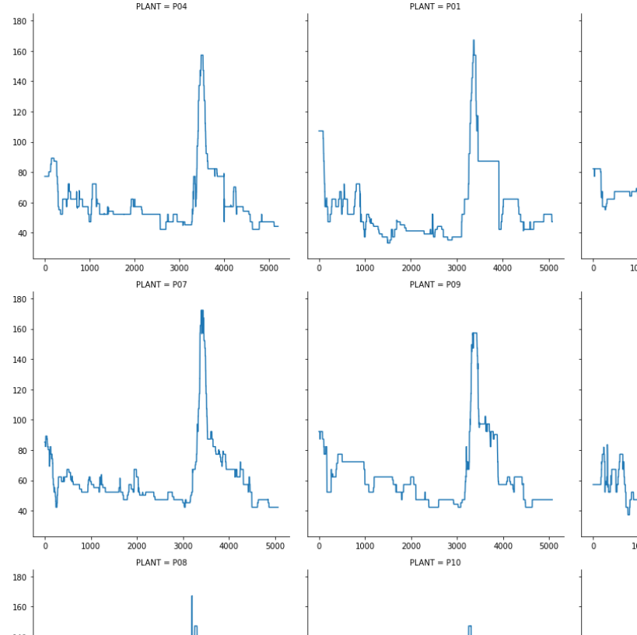
Exploratory analysis of data
Observations:
10 plants
P02 only operating for a short amount of time
Distribution was visually checked using a histogram and shown to be right skewed
Time series plot showed that all of the plants had a similar shape

Slide 4
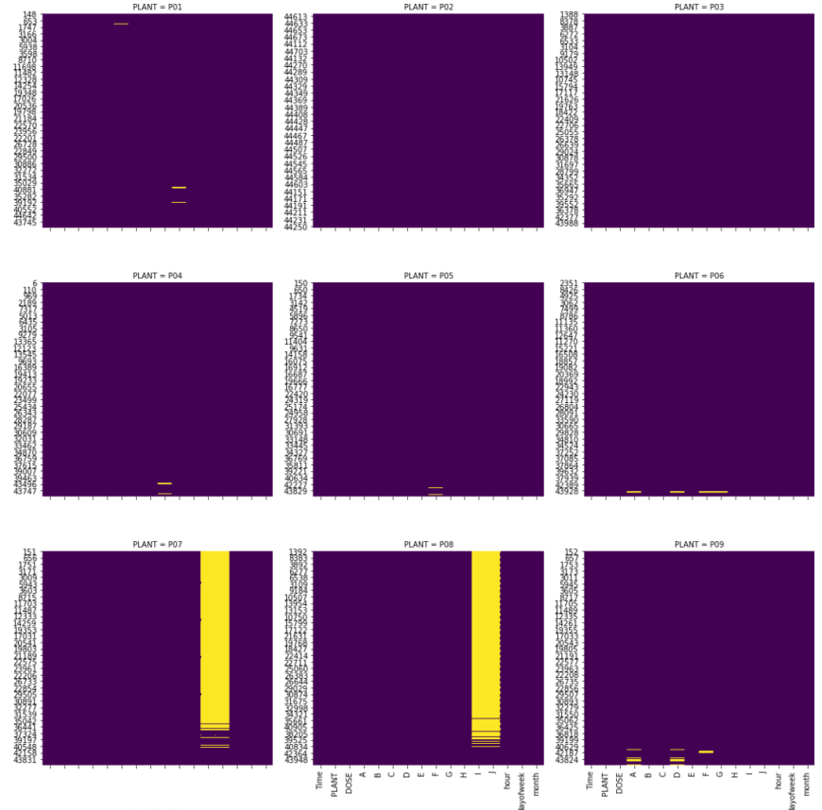
Methods of outlier detection and other data cleaning steps
Checked for missing values, none detected
Checked for non-numeric values, the only type detected was #VALUE!
Heatmap plotted to visualise extent of #VALUE!
Most of the plants had some sparse #VALUE! values
Cleaned by using the previous non #VALUE! datapoint
P07 and P08 had almost all of their ‘I’ and ‘J’ parameters as #VALUE!
Decided to remove these two parameters from P07 and P08 and model these two Plants separately from the main group
Other than

Slide 5
Model selection and validation process
A gradient boosting regressor model was used because it has been used effectively by other data scientists for time series modelling.
In addition, a low and high prediction interval can be estimated by specifying a low and upper quantile. In this case, 0.1 and 0.9 were chosen respectively.
The TimeSeriesSplit function was used to split the data into 4 folds in order to use cross validation
The GridSearchCV function was used to fit the model according to the split data
Max depth was used as the only parameter in the grid search

Slide 6
Selection of accuracy metric(s) and prediction accuracy achieved
the coefficient of determination R^2 of the prediction was used
The main model (ie. all the plants excluding P07 and P08), obtained a score of 0.909
The P07_P08 model obtained a score of 0.958

Slide 7
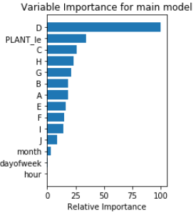
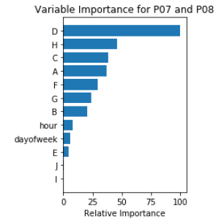
Variables that are most important to predicting dose rates
Parameter ‘D’ was clearly the most important predictor, followed by C and H
For the main model (ie. all the plants excluding P07 and P08), the PLANT id field (PLANT_le) came up as a strong predictor for the main model, suggesting that there are significant differences between the plants

Slide 8
how such a dosing model can be implemented, monitored and utilized
Since the team is already using Azure, use the Azure MLOps services to deploy to the cloud.
Publish the final model to Azure ML Register
Create Docker container (packaging all the dependencies)
Use Kubernetes to deploy to webservice
Can feed the predicted data to a dashboard (Power BI)
Some other benefits of using Azure MLOps:
can easily keep track of models and where they are deployed (there could potentially be a separate model deployed to each treatment plant)
streamline model maintenance activities

Slide 9
other methods that can be pursued
Spend more effort developing features
Try out other types of models:
Traditional timeseries (eg. ARIMA, VAR)
Structural models (eg. Prophet)
Deep learning (eg. LSTM, RNN, CNN)

